Slide 1
11.1 Introduction

Slide 2
In Chapter 10 we saw how supervised and unsupervised learners alike can be extended to perform nonlinear learning via the use of nonlinear functions (or feature transformations) that we engineered ourselves by visually examining data.
Here we detail the fundamental tools and principles of *feature learning* (or *automatic feature engineering*) that allow us to automate this task and *learn* proper features from the data itself.

Slide 3
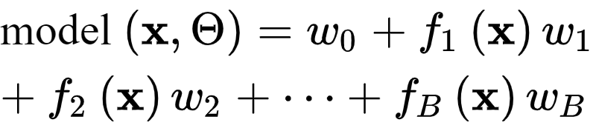
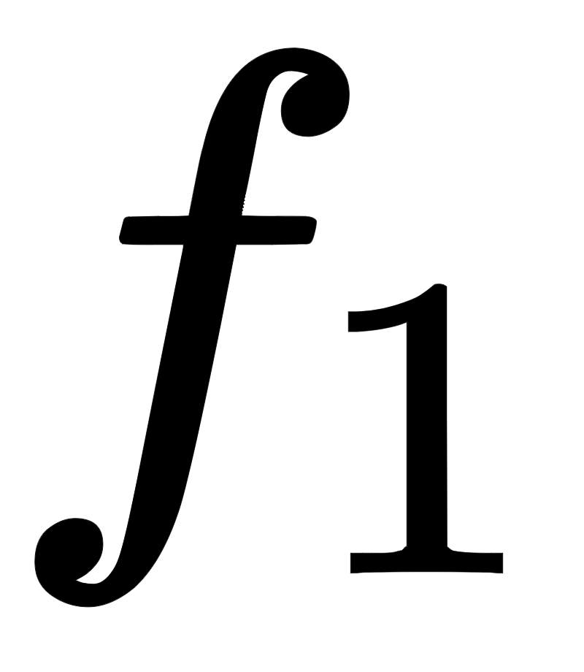
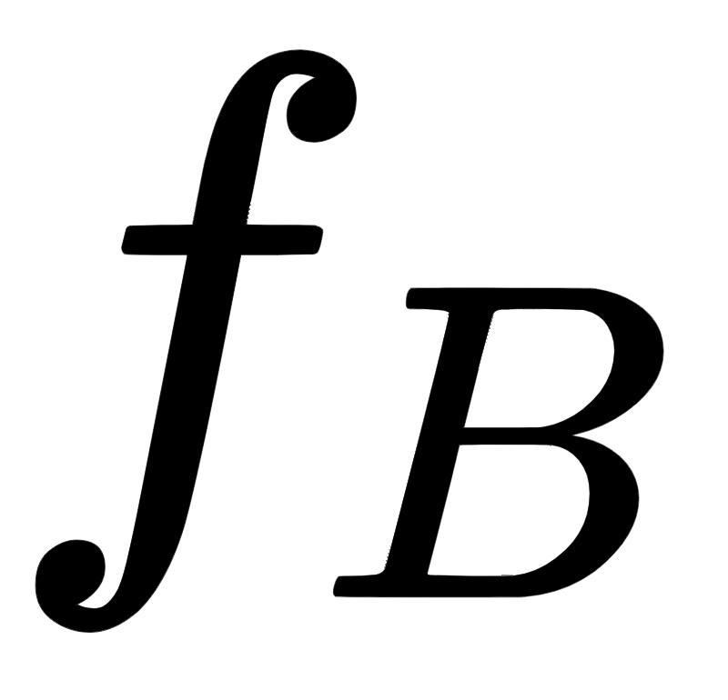

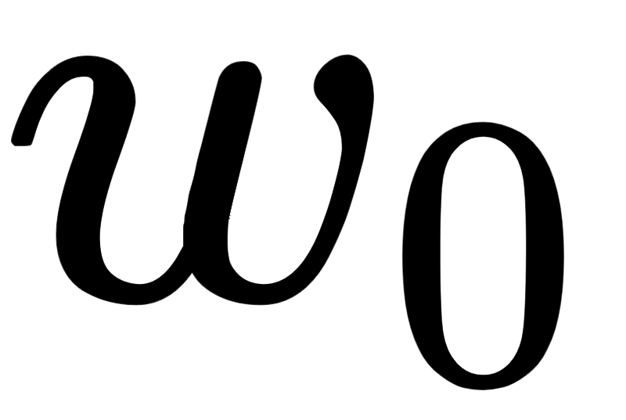
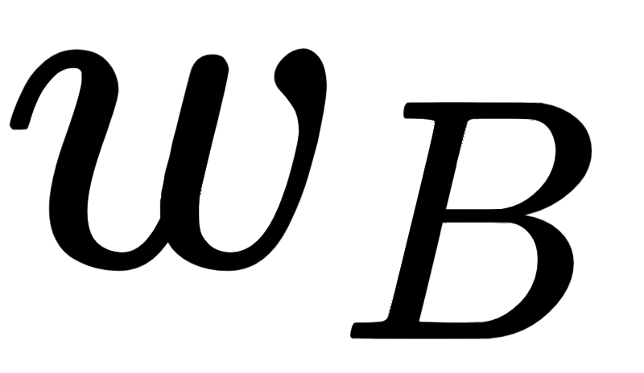
More specifically, expressing a general nonlinear model for regression and two-class classification as a weighted sum of B nonlinear functions of our input as
we will discuss how to:
choose the form of the nonlinear transformations through
the number B of them employed
and, how the parameters in (including through ) are tuned, *automatically* and for *any dataset*

Slide 4
The complexity dial metaphor of feature learning

Slide 5
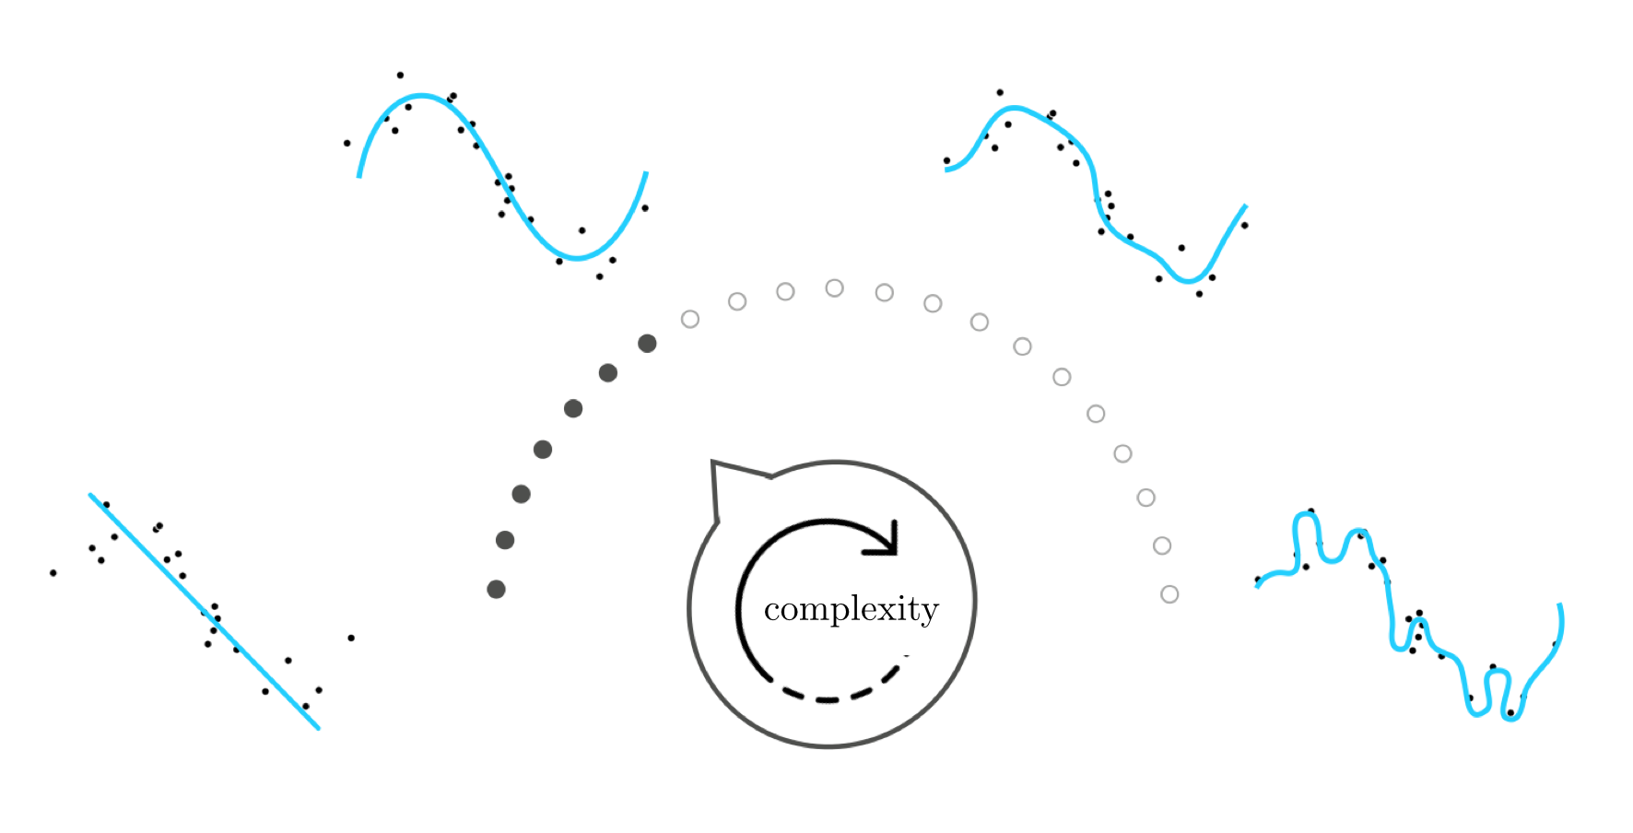
We can think about feature learning metaphorically as 1) the *construction* of and 2) the *automatic setting* of a *complexity dial*, like the one shown below for a simple nonlinear regression dataset.

Slide 6
This 'complexity dial' conceptualization visually depicts the challenge of feature learning at a high level as a dial that must be built and automatically tuned to determine the appropriate amount of model complexity needed to represent the data.

Slide 7
Setting this complexity dial all the way to the left corresponds to choosing a simple form for the nonlinear model that results in a representation of low complexity (e.g., a linear model)
If turned too far to the right the resulting model will be too complex (or too 'wiggly') with respect to the training data.
When set 'just right' the resulting model represents the data - as the underlying phenomenon generating it - very well.

